Slide 1
Predicting MPG
From fuel bills to a four-variable equation to the 2045 fleet
weight · horsepower · footprint · hybrid — R² = 0.846
OS 3810 Probability & Statistics — Final Project
EPA Model Year 2024 compliance data, 1,025 vehicles
Notes:
Arc: what fuel costs households, the equation that predicts MPG, why raw MPG misleads (design drift), the normalized productivity law, classes, buyers, EVs, and the 2045 projection.

Slide 2
Fuel is a four-figure annual bill, and MPG sets it
$2,463
$1,007
$49,855
annual energy cost of the median gasoline vehicle (15,000 miles, 2024 prices)
the same year of driving in the median battery-electric vehicle
average price actually paid for a new vehicle, July 2026 (KBB)
MPG is the lever connecting vehicle design to what drivers spend. If MPG can be predicted from design, consumer cost can be predicted from the sales mix.
Research question: which physical design variables predict a vehicle's fuel economy, and how well?
Costs: fueleconomy.gov catalog efficiency x BLS national prices (reports/23_powertrain.md). ATP: Kelley Blue Book / Cox Automotive, July 2026.
Notes:
Open with money. A gas car burns ~$2,500 a year, an EV ~$1,000, and the average new vehicle costs $50k. MPG is the design lever behind the fuel line. Research question on screen.

Slide 3
One dependent variable, four independent variables
Variable | Expected sign | Physical reason
ln(weight) | − | more mass to accelerate
ln(horsepower) | − | bigger engine, richer fueling
footprint | − | frontal area and rolling drag
hybrid | + | regenerative braking, engine right-sizing
DEPENDENT (y): combined MPG — EPA unadjusted 2-cycle, one row per MY2024 combustion model type
INDEPENDENT (x): 1. Inertia weight (lbs)
2. Rated horsepower
3. Footprint (sq ft)
4. Hybrid powertrain (0/1)
Hypothesis: all four reject zero, signs as above, and together they explain the majority of MPG variation across the fleet.
EVs excluded from this model: MPGe is a different physical quantity (a separate BEV model appears in backup).
Notes:
MPG is the dependent variable; the four design measures are independent. Signs predicted before fitting. WHAT 2-CYCLE MEANS if asked: EPA's two laboratory dynamometer driving cycles - a simulated stop-and-go CITY drive (the FTP) and a steady ~48 mph HIGHWAY drive - blended 55/45 into 'combined'. 'Unadjusted' = the raw lab results with no correction toward real-world driving; this is the measurement CAFE compliance uses. The window sticker uses 5-cycle testing (adds high-speed, air-conditioning, and cold-weather cycles) and reads lower; real-world driving is lower still (~31% below 2-cycle by 2024, per the lab-vs-road chart). We chose 2-cycle deliberately: one consistent, physics-clean test applied identically to every vehicle.

Slide 4
The data: EPA's own compliance filings, MY2024
 | MPG (DV) | Weight (lbs) | Horsepower | Footprint (sq ft)
Min | 11.2 | 2,250 | 78 | 37.2
Median | 29.3 | 4,500 | 302 | 49.7
Max | 80.5 | 7,000 | 1,600 | 75.1
n = 1,025 combustion model types — every configuration manufacturers legally filed for model year 2024 205:1 observations per estimated parameter (course rule of thumb: 10:1) 100% join rate between the fuel-economy and footprint files on (manufacturer, division, carline)
Provenance: every raw file, URL, and checksum is logged (DATA_SOURCES.md); the pipeline is 31 idempotent scripts; rerunning any stage reproduces identical outputs.
EPA Model Year 2024 Fuel Economy & Technology data + Footprint data (epa.gov/automotive-trends); joined in outputs/my2024_config.csv.
Notes:
Compliance filings, not surveys. One row per model type; checksummed chain of custody. WHAT '100% JOIN RATE' MEANS if asked: EPA publishes the fuel-economy data and the footprint data as two SEPARATE files, so rows must be matched between them before footprint can appear in the model. The matching key is the triplet (manufacturer code, division code, carline code) - e.g., GM / Chevrolet / Silverado 4WD. 100% means every one of the 1,052 carlines in the fuel-economy file found its partner in the footprint file AND vice versa - zero orphans, no fuzzy name matching, no dropped vehicles, no imputation. That matters because merging separately published files is where data usually leaks away silently; ours lost nothing.

Slide 5
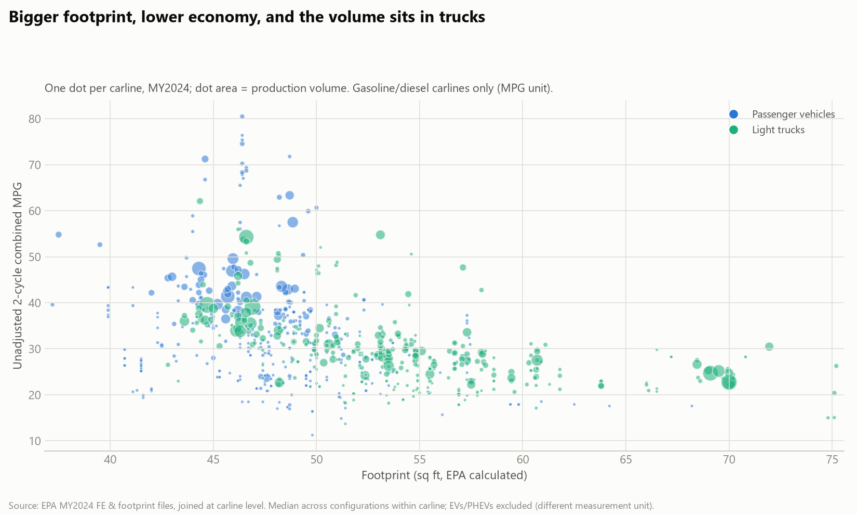
The relationship is visible before any model is fit
Bigger vehicles cluster low, small hybrids high — and the production volume (dot size) sits with the trucks. The regression's job is to separate size, power, and powertrain, which move together.
Notes:
Raw scatter first, model second. The pattern is obvious; regression disentangles correlated causes and bounds each. Footprint is one of three: weight and horsepower follow.

Slide 6
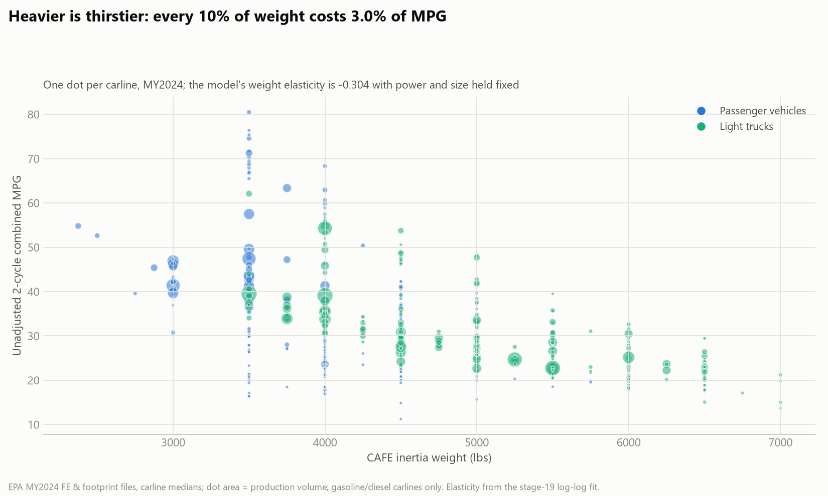
Heavier is thirstier: 10% more weight costs 3.0% of MPG
Same construction: one dot per carline, dot area = production. The vertical spread at each weight is what the other predictors (power, hybrid) explain.
Notes:
Second raw relationship: weight. Note the vertical spread at fixed weight - hybrids sit high, performance engines low. That spread is why one predictor is not enough.

Slide 7
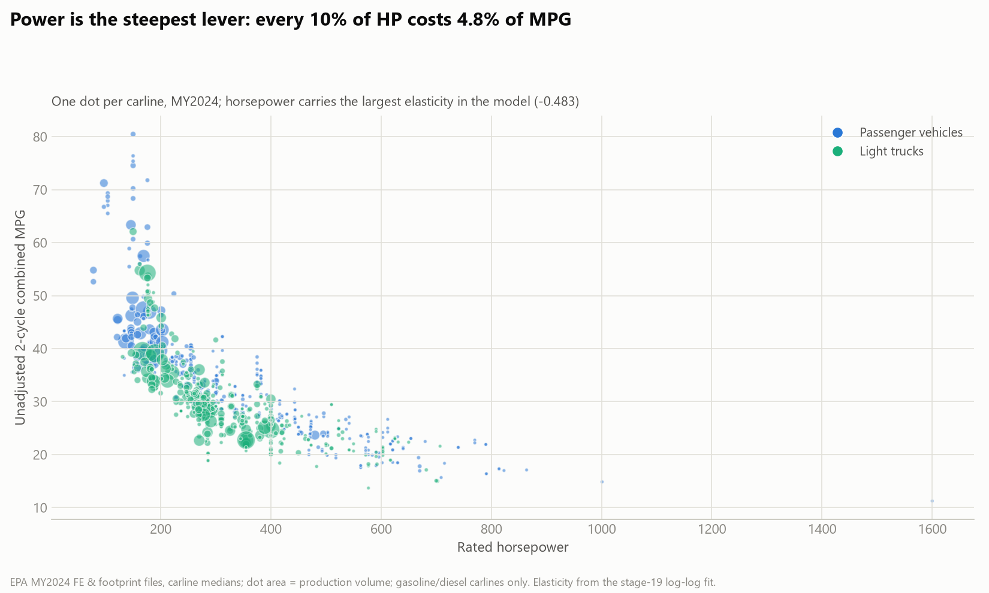
Power is the steepest lever: 10% more HP costs 4.8% of MPG
The cleanest curve of the three — a power law the log-log model straightens into a line. Horsepower carries the largest elasticity in the fit.
Notes:
Third raw relationship and the strongest: horsepower. Visibly a power law, which motivates the log transform on the derivation slide.

Slide 8
Deriving the model: multiplicative physics, linear estimation
ln(MPG) = 8.78 − 0.304·ln(weight) − 0.483·ln(HP) − 0.0022·footprint + 0.207·hybrid + ε
1
2
3
Multiplicative physics Fuel burn scales with mass moved and power demanded, so effects multiply rather than add. Taking logs turns the multiplicative law into a straight line OLS can estimate.
Elasticity coefficients In log-log form each coefficient is an elasticity: a 1% change in the predictor moves MPG by that many percent. The hybrid dummy exponentiates to a percent premium.
Honest uncertainty Ordinary least squares, with HC1 heteroskedasticity-robust standard errors: variance differs across vehicle classes, so robust errors keep the p-values honest.
Fit in 19_final_model.py; full table in reports/19_final_model.md. Alternative specifications in backup.
Notes:
The equation, verbatim. Why logs, why elasticities, why HC1. Slow down here. WHAT EPSILON MEANS if asked: the error term - everything that determines a vehicle's MPG that the four predictors do not capture (aero tuning, gearing, tires, calibration). Without epsilon the equation would claim four numbers determine MPG EXACTLY, which is false; with it, MPG = systematic part + vehicle-specific residual. Epsilon is why the dots on the predicted-vs-actual slide scatter around the 45-degree line rather than sitting on it, and R-squared = 0.846 literally means the predictors explain 85% of variance while epsilon carries the other 15%. Soundbite: 'epsilon is the 15%.'

Slide 9
Results: every predictor significant, R² = 0.846
Term | Coefficient | HC1 SE | t | p | VIF
intercept | 8.778 | 0.274 | 32.0 | < 0.001 | —
ln(weight) | −0.304 | 0.041 | −7.4 | < 0.001 | 3.4
ln(horsepower) | −0.483 | 0.011 | −43.0 | < 0.001 | 1.5
footprint (sq ft) | −0.0022 | 0.0010 | −2.3 | 0.022 | 2.5
hybrid | +0.207 | 0.010 | 21.2 | < 0.001 | 1.1
R² = 0.846
adjusted R² 0.845 — the four predictors explain 85% of ln(MPG) variance
F = 1,401
F(4, 1020), p < 10⁻¹⁵; VIF ≤ 3.4 = mild, manageable collinearity
OLS with HC1 robust SEs, n = 1,025. Footprint's small coefficient reflects size traveling with weight; dropping it changes nothing (backup).
Notes:
All four reject zero. R-squared 0.846, adjusted identical. VIF max 3.4: collinearity present but tame. WHAT F = 1,401 MEANS if asked: the whole-model test. Null hypothesis: all four coefficients are zero - the predictors collectively explain nothing. F is the ratio of variance explained by the model (per parameter) to variance left unexplained (per residual degree of freedom) - hence F(4, 1020): 4 parameters against 1,025 - 5 = 1,020 residual df. Under the null this ratio hovers near 1; ours is 1,401, p below 10 to the -15. This is the ANOVA machinery from Chapters 9-11 applied to regression: explained vs unexplained variation, SST vs SSE. Honest caveat if pushed: with n this large F is almost always significant - the individual t-tests and effect sizes carry the interesting information; F certifies the model is not noise.

Slide 10
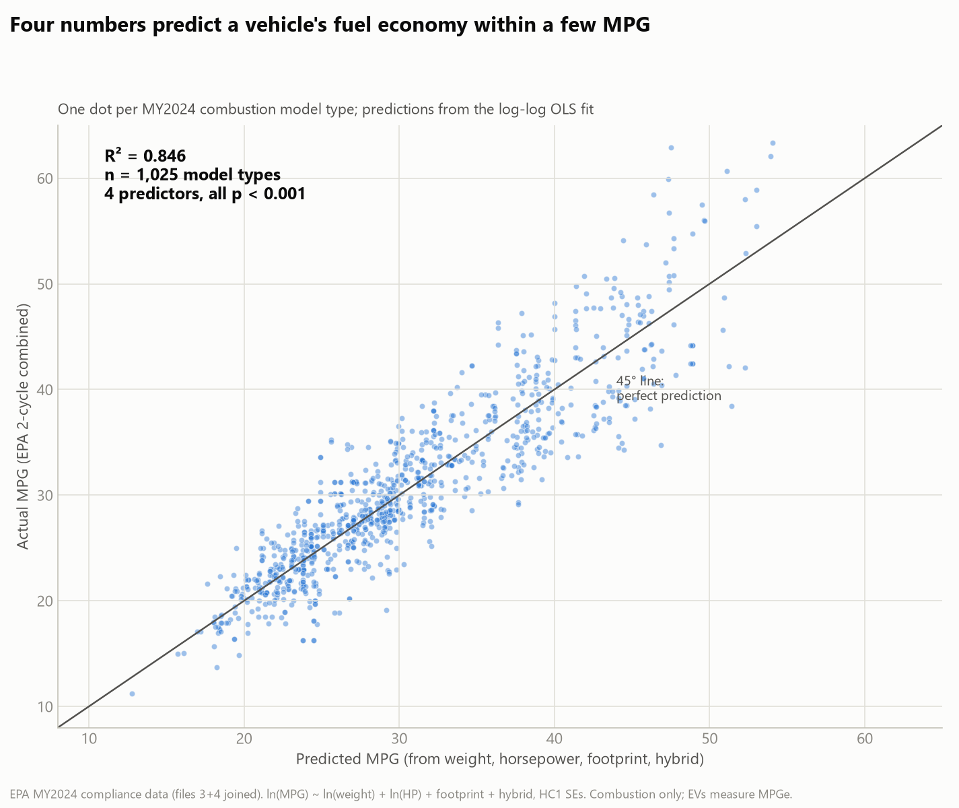
What R² = 0.846 looks like
Notes:
Predicted vs actual, one dot per model type. Typical miss is a few MPG from four numbers on a spec sheet.

Slide 11
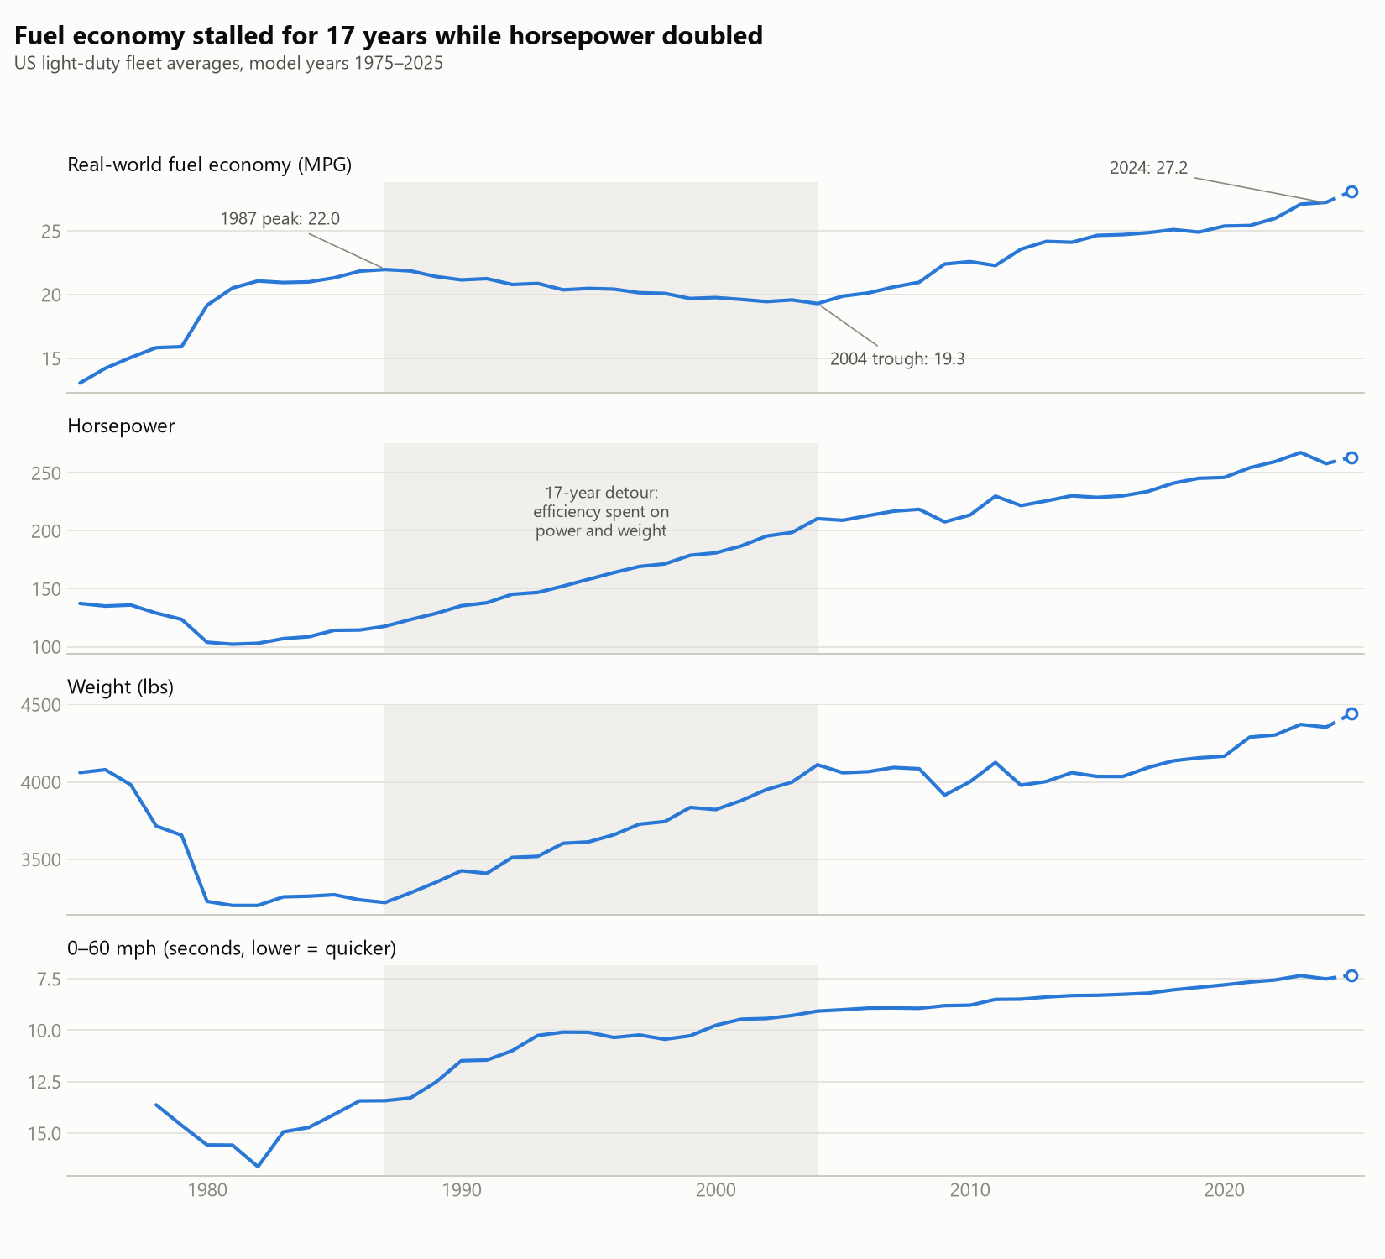
Raw MPG stalled because design drifted: safer, heavier, stronger
1987–2004: MPG falls 22.0 → 19.3 while the fleet gains 90 HP and 900 lbs. Where the weight came from: crash structures, airbags, and content — deaths per 100M miles fell from 3.35 to ~1.2 over these decades. Where the power went: the market bought acceleration — 0-60 halved from 13.4 s to 7.5 s. So raw MPG confounds technology with taste and regulation. To see technology itself, hold the design constant — the normalization our equation makes possible.
EPA Automotive Trends; fatality rate from BTS Table 2-17 (backup has the full safety chart). Era breaks confirmed by changepoint search (backup).
Notes:
The pivot slide: raw MPG is a design-confounded series. Weight bought safety (3x fewer deaths per mile), power bought acceleration. Motivates normalization using our own elasticities.

Slide 12
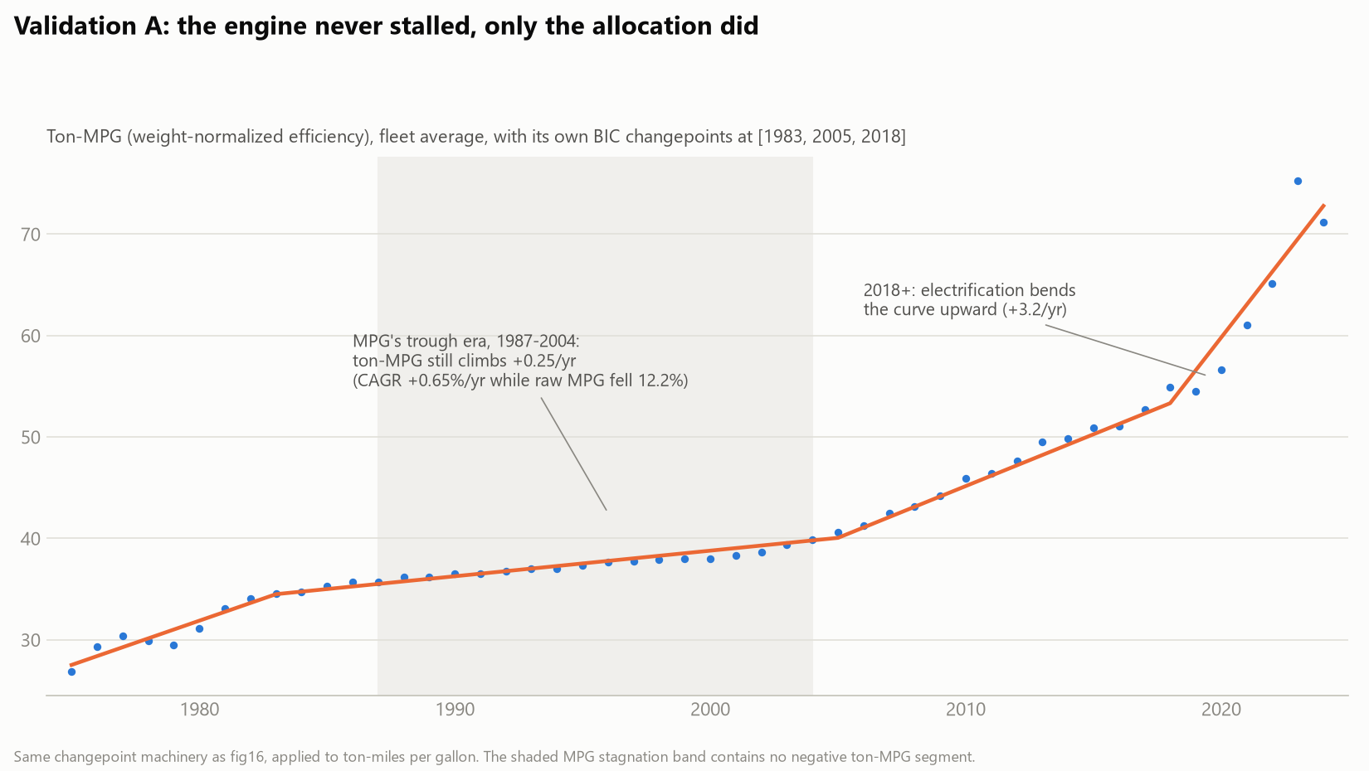
The exchange rate: what power and mass cost in MPG
−4.8%
−3.0%
+23%
MPG cost of a 10% horsepower increase — the steepest lever
MPG cost of 10% more weight, holding power and size fixed
fuel-economy premium of a hybrid powertrain at identical weight, power, size
First proof that the trough was allocation, not stagnation: weight-normalized efficiency (ton-MPG) climbed every single year of 1987–2004. The elasticities price the trade: the industry bought acceleration and size with fuel economy at about half a percent of MPG per percent of horsepower.
Elasticities from the log-log fit. Left: fig22 — ton-MPG changepoint analysis (validation A).
Notes:
Elasticities in words; hybridize before lightweighting. Ton-MPG is the crude version of the normalization; the next slide does it properly with both elasticities.

Slide 13
How we normalized: divide out the design, keep the technology
1
2
3
The model gives exchange rates MPG scales with weight^-0.304 and HP^-0.483 (the elasticities we just estimated). Those exponents price what design costs in fuel economy.
Re-price every year at 2024 design Multiply each year's fleet MPG by (weight/weight2024)^0.304 x (HP/HP2024)^0.483 — scaling away the advantage of being lighter and weaker than 2024.
What remains is technology Every year now describes the same hypothetical vehicle — 2024's weight and power — built with that year's engineering. One moving part instead of three.
Worked example — 1987: raw fleet MPG 22.0, but the fleet weighed 3,221 lbs with 118 HP vs 2024's 4,354 lbs and 258 HP. 22.0 × (3221/4354)^0.304 × (118/258)^0.483 = 22.0 × 0.91 × 0.69 ≈ 13.8
1987's technology, asked to move 2024's fleet, delivers ~14 MPG — not 22. That is the normalized point plotted for 1987.
Elasticities from the stage-19 fit; construction in 29_productivity.py. Assumption stated on the limitations slide: 2024 elasticities held across eras.
Notes:
EXACTLY what is happening: the regression says MPG is proportional to weight^-0.304 times HP^-0.483 times a technology level. So technology level = MPG divided by those design terms. To COMPARE years, we evaluate every year's technology at one common design point (2024's fleet weight and power). The multiplication by (wt/wt2024)^0.304 and (HP/HP2024)^0.483 does that: for a light, weak 1987 fleet both ratios are below 1, so raw MPG gets scaled DOWN - 1987's 22.0 becomes ~13.8, the MPG its technology would have delivered pushing 2024 metal. Because the model is log-log (multiplicative), design separates from technology as clean ratio factors; that is WHY we fit in logs. Key assumption to volunteer: the elasticities are 2024 cross-sectional values applied historically; era refits (R-squared 0.71-0.78) support but cannot prove stability. Why 2024 as the reference: any year works mathematically - the whole curve just shifts; 2024 makes the endpoint equal today's actual fleet so the numbers read in today's terms.

Slide 14
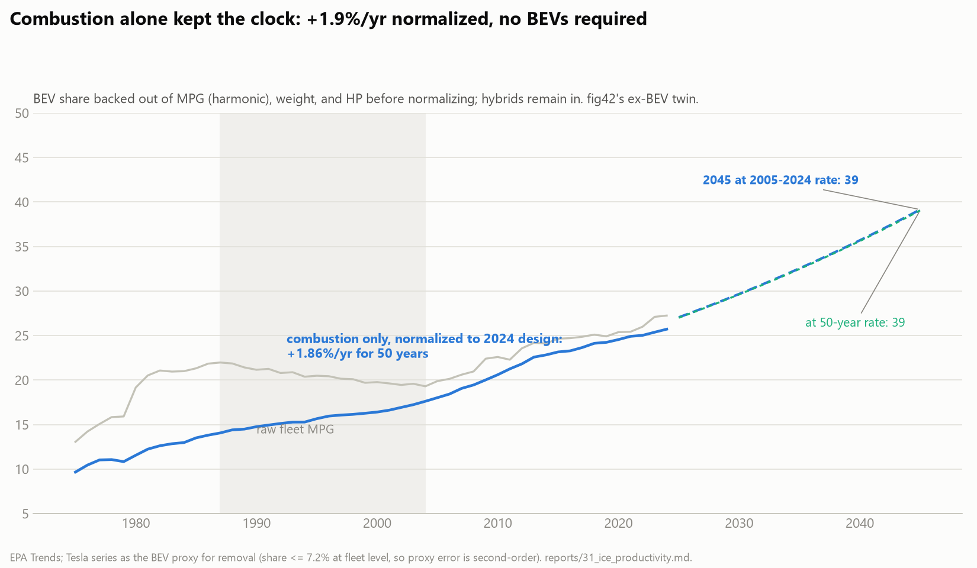
Normalize the design away, and efficiency never stalled
MPG_norm = MPG × (wt/wt₂₀₂₄)^0.304 × (HP/HP₂₀₂₄)^0.483 Every year's fleet re-expressed at 2024's weight and power, using our own coefficients — combustion only (BEVs backed out). +1.86%/yr for fifty years, R² = 0.984. The trough vanishes: technology never paused; its gains were spent.
Stage 31; hybrids remain; BEV share backed out harmonically via the Tesla proxy (fleet share <= 7.2%). BEV-inclusive version in the projection slide.
Notes:
The payoff of the equation beyond prediction: it is a measuring instrument. Normalized, combustion productivity is a 50-year straight line in log space. The mechanics were just shown on the how-we-normalized slide; if the worked example is requested again: 1987's raw 22.0 MPG times (3221/4354)^0.304 times (118/258)^0.483 = 22.0 x 0.91 x 0.69 = ~13.8 - what 1987 technology delivers pushing 2024 weight and power. This slide additionally backs BEVs out (harmonically for MPG, arithmetically for weight/HP, Tesla series as proxy) so the line is pure combustion.

Slide 15
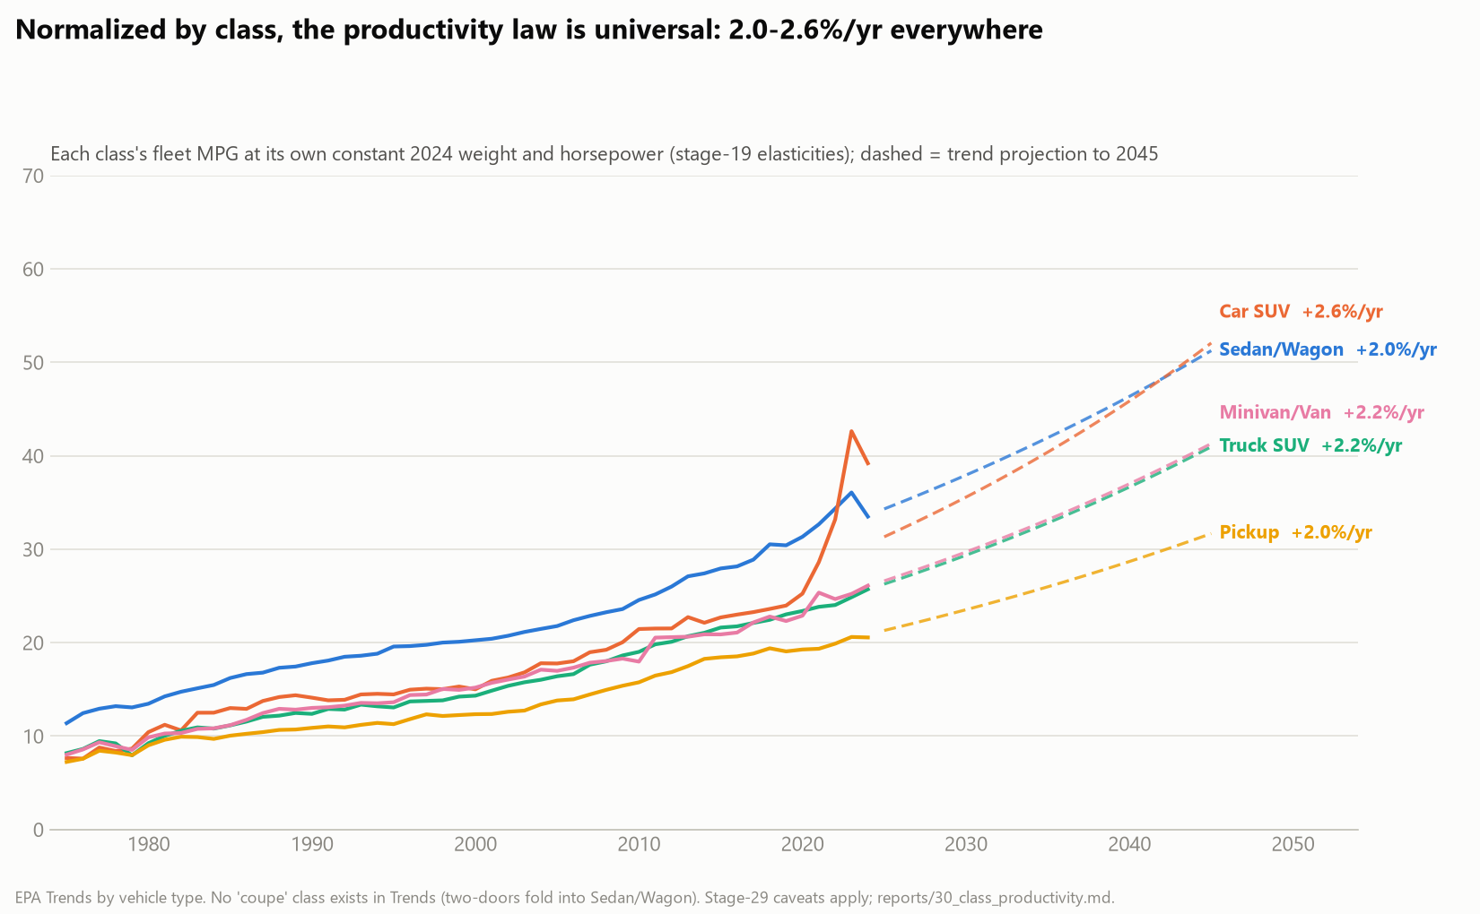
The productivity law holds in every class of vehicle
Sedans, SUVs, pickups, minivans — each normalized to its own 2024 design: 2.0–2.6%/yr everywhere, R² 0.93–0.99. Classes differ in level (pickup physics), barely in rate. The one outlier — Car SUV's 2023 spike — is the Model Y entering the class at 36% share; it vanishes when BEVs are removed (backup).
EPA Trends by vehicle type; no coupe class exists in Trends (two-doors fold into Sedan/Wagon). reports/30_class_productivity.md.
Notes:
Same law per class. Pre-empt the spike question here by naming it; full decomposition sits in backup.

Slide 16
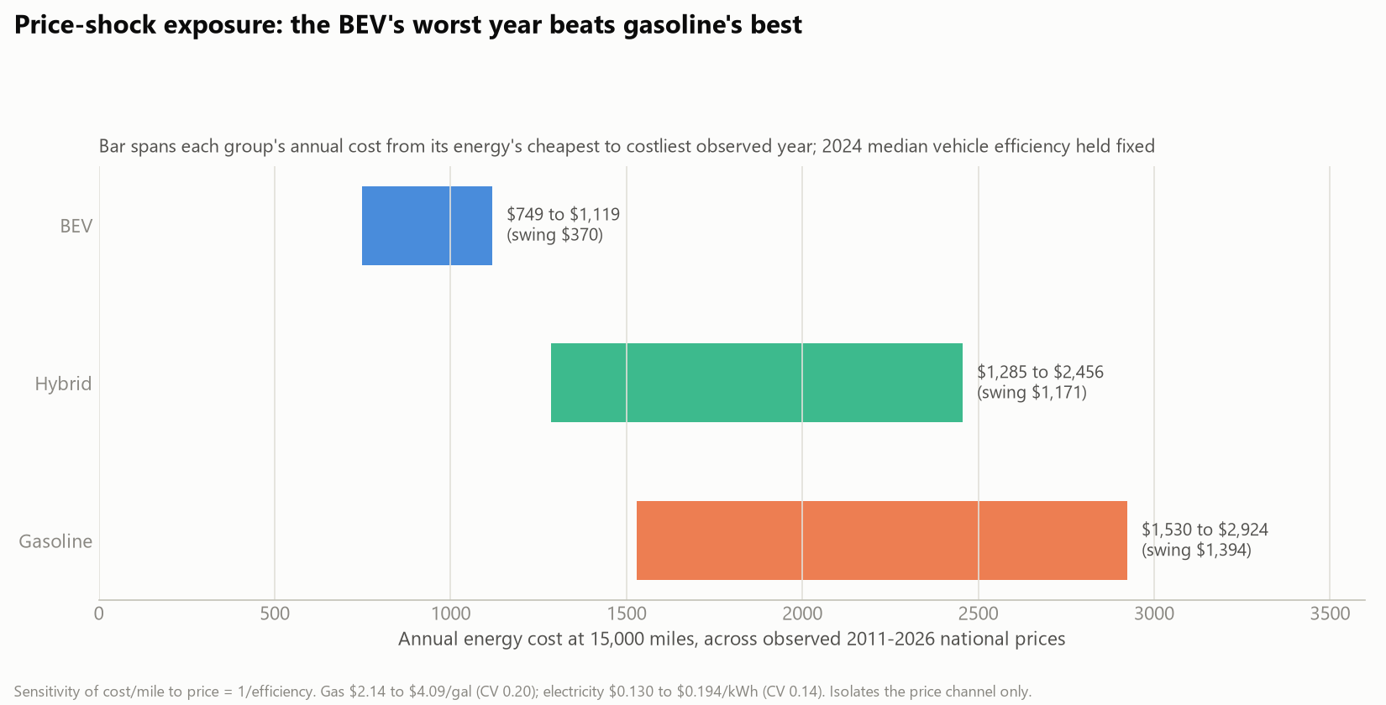
Why buyers care: MPG is a cash-flow forecast
4.5 years
energy savings alone repay the $6,477 EV purchase premium ($1,456 saved per year)
And the volatility story: across every price observed 2011–2026, the gasoline driver's annual bill swings $1,394; the BEV driver's swings $370. The efficient vehicle is also the price-shock insurance.
fig36 (price-shock exposure); premium from KBB July 2026 ATPs (fig37); savings from fig33 cost-per-mile at 2024 prices.
Notes:
Predicted MPG converts to dollars per year; payback arithmetic; the worst BEV year beats the best gasoline year.

Slide 17
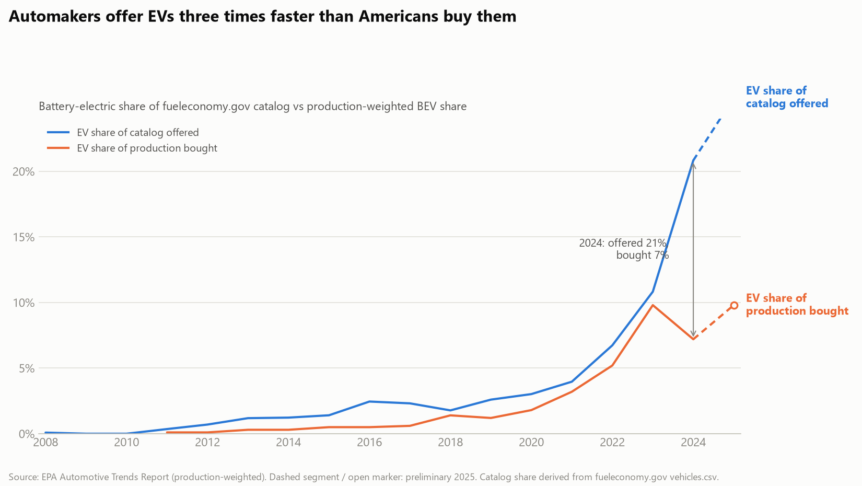
EVs: offered faster than bought, and credit-sensitive
2010: first mass-market EVs delivered (Leaf, Volt) 2022: Inflation Reduction Act revamps the $7,500 credit 2023: credit-driven surge — BEV share of the Car SUV class hits 35.7% 2024: the hangover — sedan-class BEV share halves (14.6% → 7.1%) The gap persists: 21% of the 2024 catalog is electric; 7.2% of production is. Buyer interest tracks incentives and energy-cost advantage — which is narrowing (backup).
fig3 (offered vs bought); events from external/events_timeline.csv (dated, cited); mix shares from EPA Trends powertrain columns.
Notes:
EVs get their own beat: automakers offer three times faster than Americans buy; adoption is visibly policy-elastic (2023 surge, 2024 hangover). Ties to beat 6: the cost advantage is the engine, incentives the throttle.

Slide 18
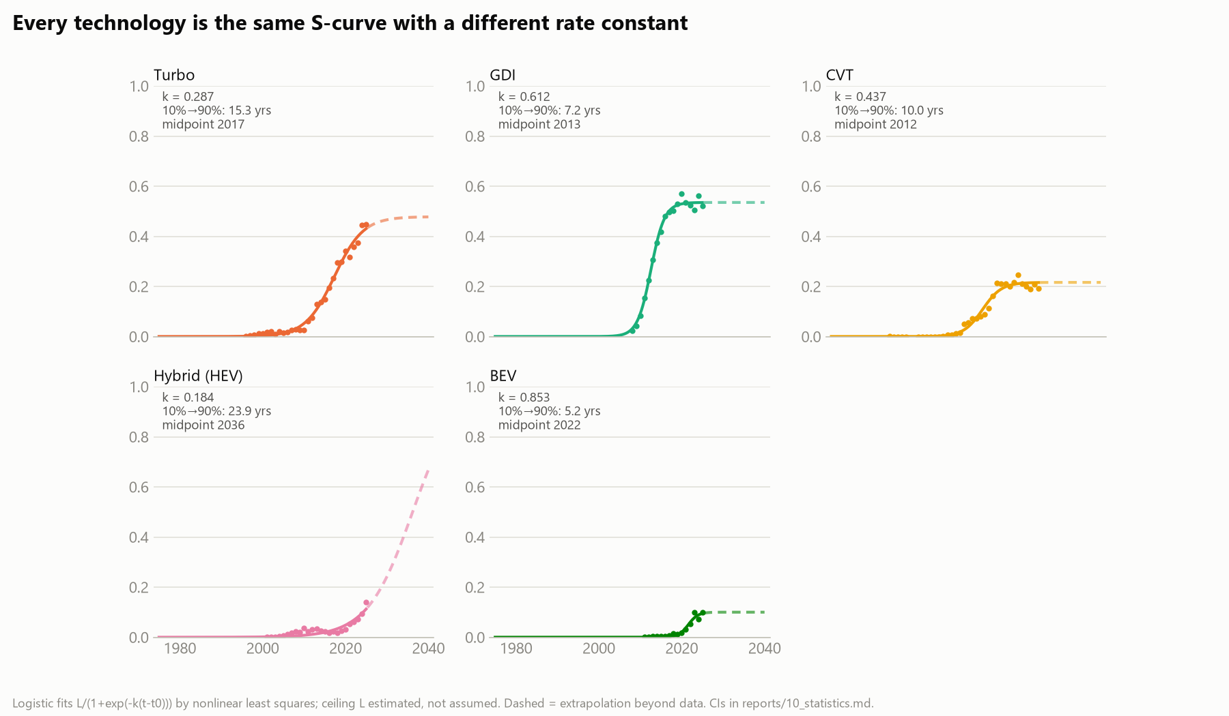
What arrives next follows the same S-curve, at different speeds
Every efficiency technology diffuses on a logistic curve; only the rate constant differs. GDI took over 2.1× faster than turbo. The honest open question is BEV: the data cannot yet distinguish an early S-curve from a low plateau — its fitted ceiling carries the widest confidence interval on the page.
Logistic fits, ceiling estimated not assumed; bootstrap CIs in reports/10_statistics.md. Dashed = extrapolation.
Notes:
Forward view of technology: same functional form, different clocks. Say 'believe the dashes least' about BEV.

Slide 19
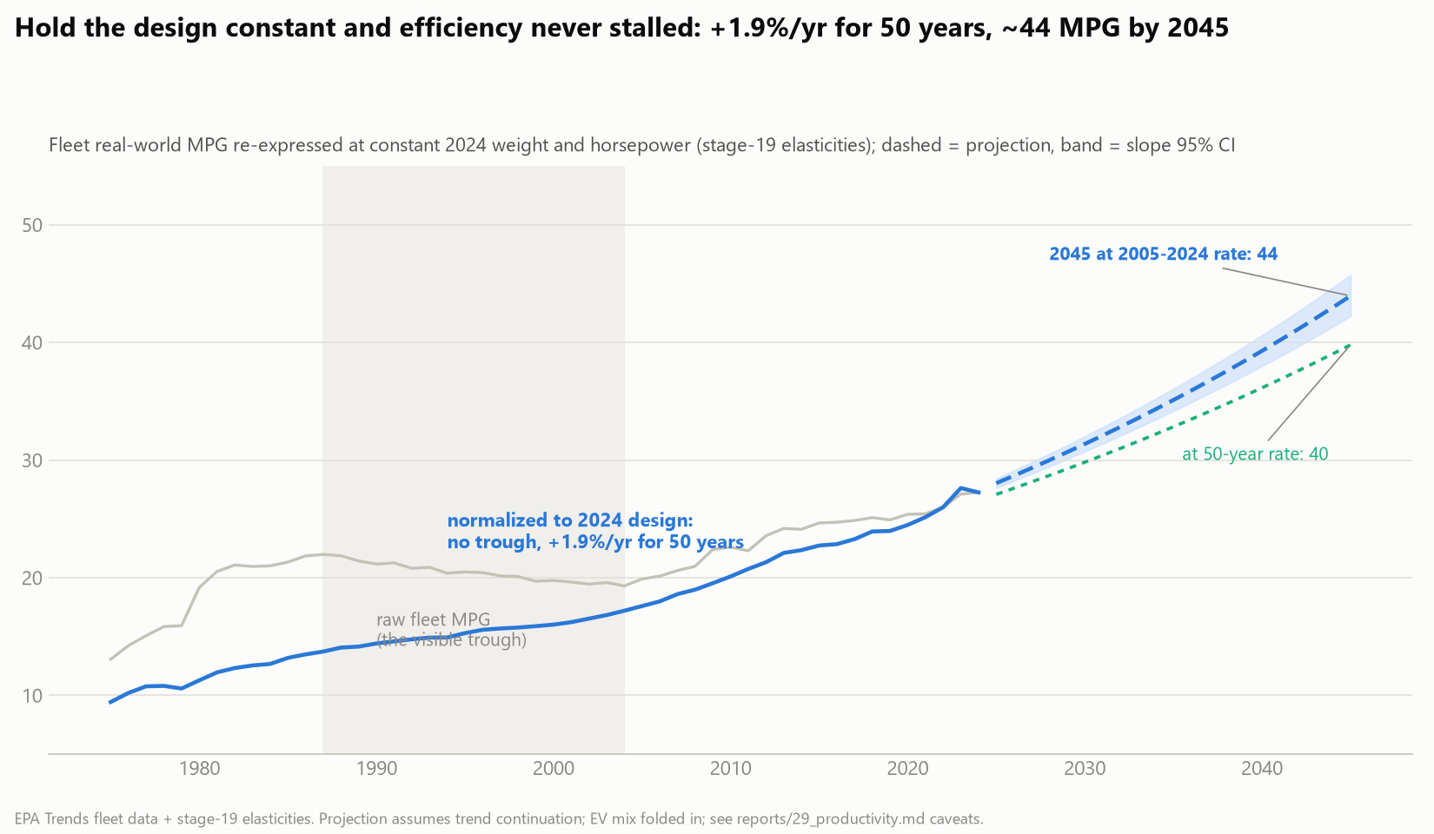
At trend: 40–44 MPG-equivalent by 2045, and the sales mix decides
The full-fleet projection (BEVs in): 44 by 2045 at the recent rate, 40 at the 50-year rate. Combustion alone delivers 39 (previous slide's series projected) — so ~5 MPG-equivalent of the difference is electrification's contribution, which the sales mix, not the lab, will decide. Design → MPG → cost/mile → what consumers buy → fleet fuel economy: with the equation in hand, each link is quantified.
Stage 29/31; slope-CI band shown; scenario uncertainty dominates and the two rates bracket, not bound, the future.
Notes:
Land the plane: projection with and without electrification, the gap as the consumer-choice term. The chain sentence is the thesis.

Slide 20
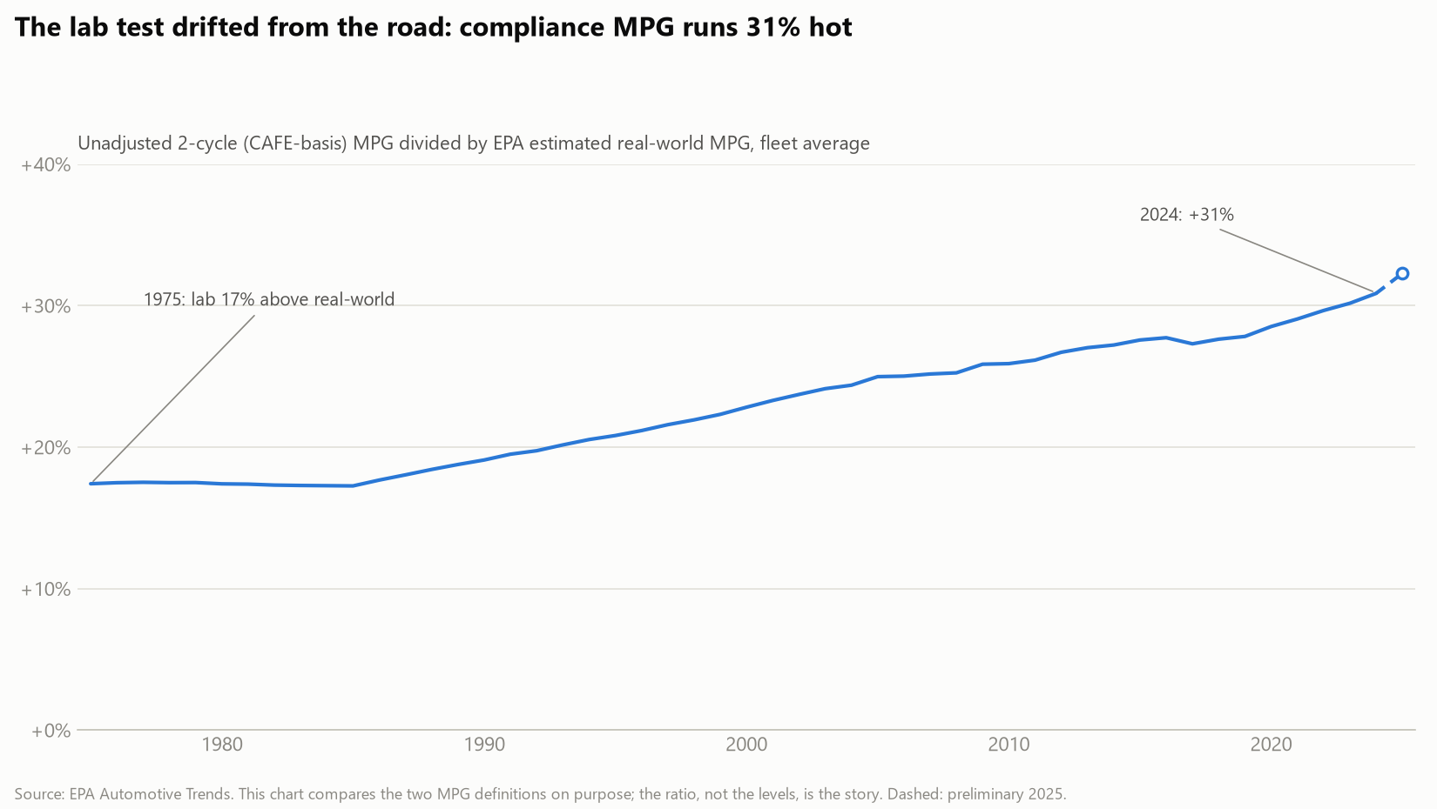
Limitations, stated plainly
Cross-sectional elasticities. Estimated on the 2024 fleet, applied across five decades for normalization: a stability assumption, partially supported by era refits (R² 0.71-0.78).
Lab MPG, not window sticker. The DV is the unadjusted 2-cycle test — a consistent basis, but it runs ~31% above real-world driving by 2024 (chart at right).
Projections are trend extrapolations. Log-linear, no physics ceiling, no policy scenario; the CI bands carry fit uncertainty only, and scenario uncertainty dominates.
The lab-vs-road gap, 1975–2024
EVs modeled separately; Tesla as BEV proxy. MPGe is a different quantity (BEV companion model, R² 0.708); the ex-BEV series leans on the Tesla proxy, first-order only inside 2023's Car SUV class.
Full limitations: reports/19_final_model.md, 29_productivity.md, 31_ice_productivity.md.
Notes:
Four limitations, now covering the normalization and projection too. Volunteer the elasticity-stability assumption before anyone asks.

Slide 21
Predict the vehicle, predict the wallet
0.846
+1.9%/yr
40–44
R² of the four-variable MPG equation on 1,025 MY2024 vehicles
fifty years of design-normalized efficiency productivity, R² 0.984
MPG-equivalent by 2045 at trend; the sales mix decides the last five
The chain this equation unlocks: design → MPG → cost per mile → what consumers buy → the national fleet's fuel economy.
Once MPG is predictable from design, fleet efficiency and consumer fuel spending become predictable from the sales mix — the truck takeover, the hybrid climb, and the EV transition all become forecastable dollar flows.
Questions — full pipeline, sources, and 46 supporting figures available (DATA_SOURCES.md, SHORTSTORY.md)
Notes:
Three numbers, the chain, questions. Backups stand ready: robustness, changepoints, audits, distributions, prices, the EV clock, the spike decomposition.

Slide 22
BACKUP The relationship survives every specification we threw at it
Specification | Dataset | n | R²
Main: log-log, four predictors | EPA MY2024 compliance | 1,025 | 0.846
Linear DV (MPG, not ln) | EPA MY2024 compliance | 1,025 | 0.804
Drop footprint (collinear term) | EPA MY2024 compliance | 1,025 | 0.846
Catalog model, years 2000+ | fueleconomy.gov catalog | 30,659 | 0.777
Catalog model, years 2020+ | fueleconomy.gov catalog | 7,890 | 0.710
BEV companion: MPGe on weight | EPA MY2024, true BEVs | 153 | 0.708
Two findings inside the table: 2020+ R² dips because engine downsizing compressed displacement variance — the fleet homogenized, not the physics.
BEV efficiency obeys the same mass law: weight elasticity −0.97, nearly unit-elastic.
reports/19_final_model.md and era fits (SHORTSTORY.md §3).
Notes:
Use for any 'does it generalize?' question.

Slide 23
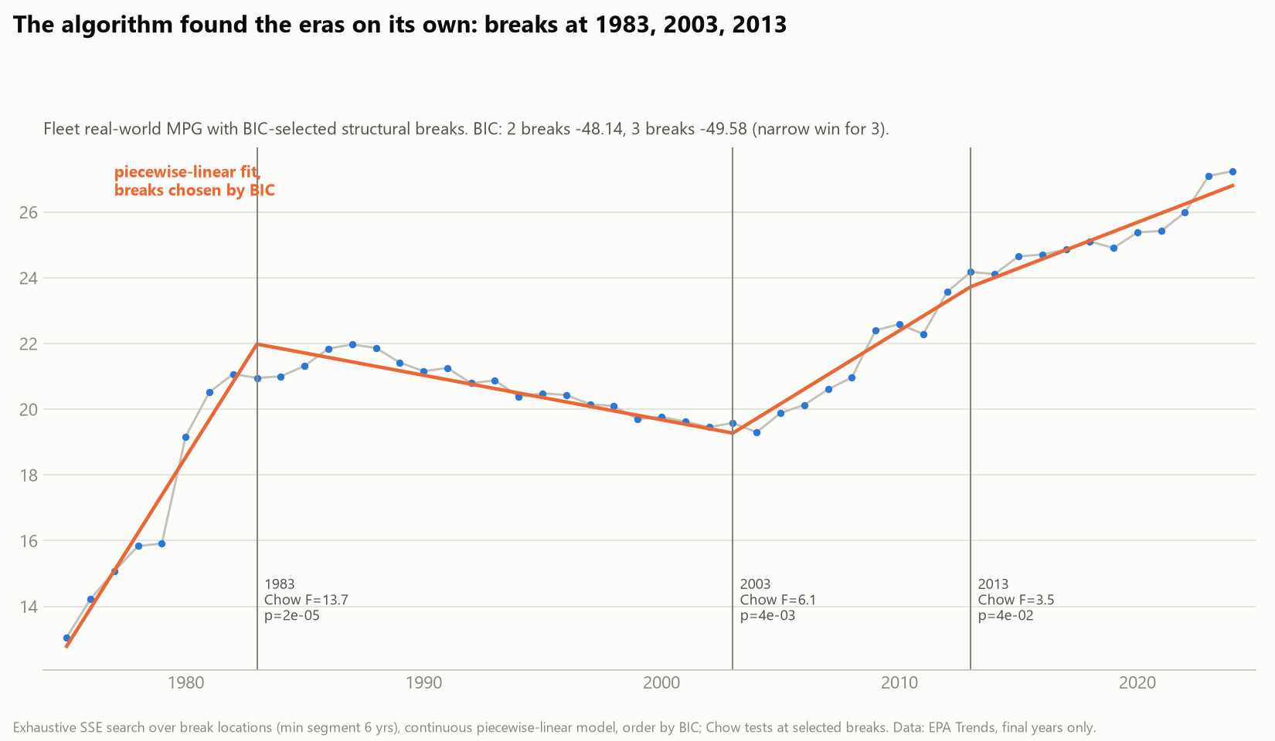
BACKUP The eras were found by algorithm, not by eye
BIC-selected piecewise-linear breaks land at 1983, 2003, and 2013, each significant by Chow test (F = 13.7, 6.1, 3.5). The three-act story is a model-selection result, not an annotation choice.
Exhaustive SSE search over break locations, order by BIC; reports/10_statistics.md.
Notes:
Use if asked how the eras were chosen.

Slide 24
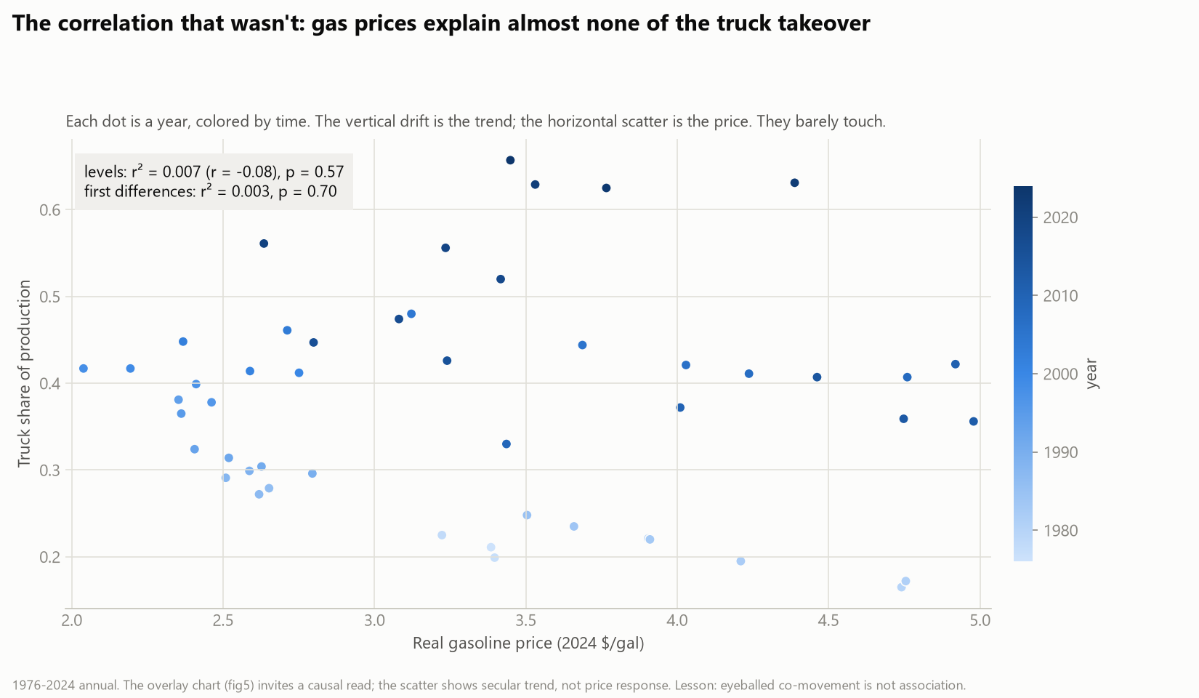
BACKUP We audited our own story: gas prices explain almost none of the mix shift
The overlay everyone believes: cheap gas killed the sedan. The regression: levels r-squared 0.007, differenced 0.003. The same audit killed the cheap-credit story (levels 0.57, differenced not significant). One episode survived testing: 1979.
1976-2024 annual; reports/10_statistics.md section 4.
Notes:
Use for causal questions about gas prices or interest rates.

Slide 25
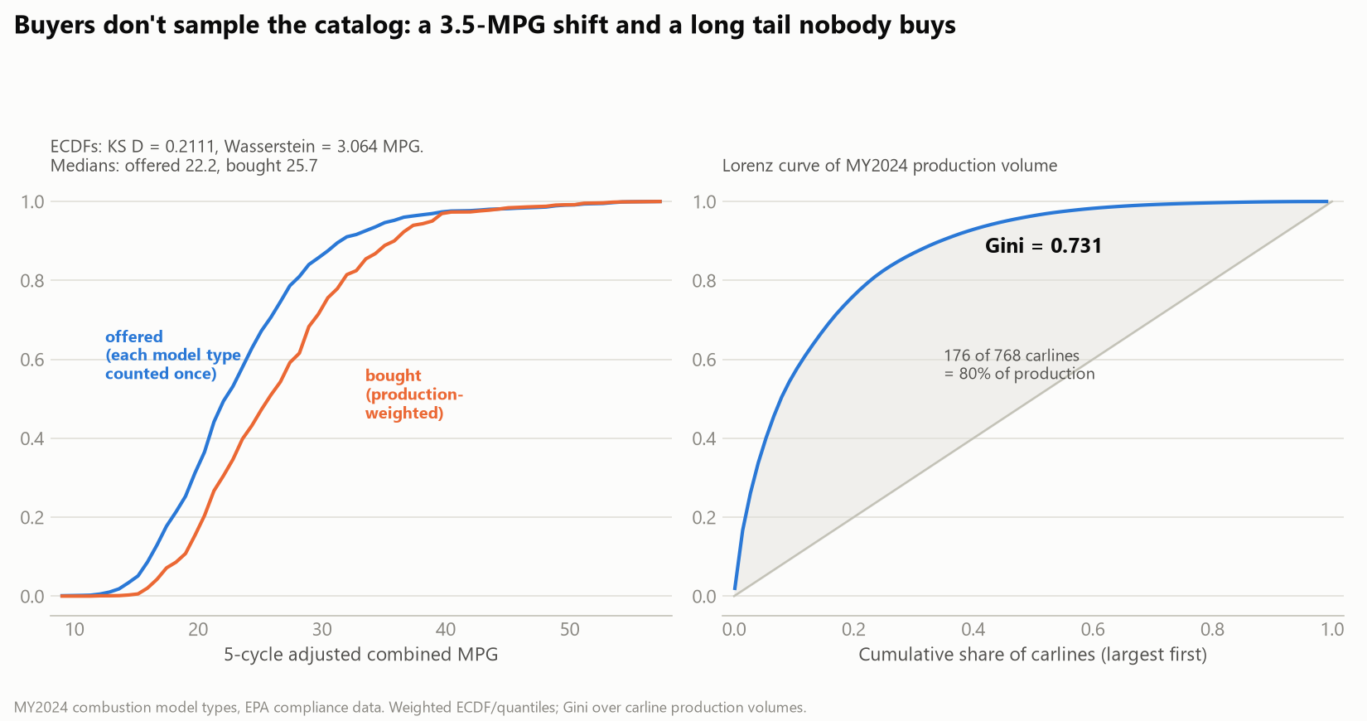
BACKUP Buyers systematically choose better MPG than the catalog median
Offered vs production-weighted MPG, MY2024: KS D = 0.211, a 3.5-MPG median shift toward efficiency, Wasserstein 3.06 MPG. Production is concentrated: Gini 0.731; 23% of carlines carry 80% of volume.
MY2024 combustion model types; reports/10_statistics.md section 2.
Notes:
Use for consumer-behavior questions.

Slide 26
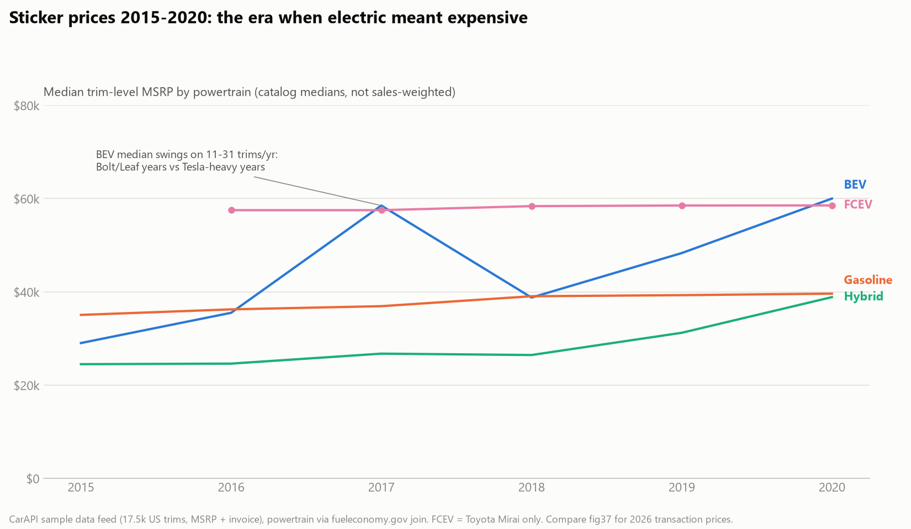
BACKUP Sticker history: the era when electric meant expensive
Trim-level MSRPs 2015-2020 (17.5k trims): hybrids the budget powertrain at $24-39k, gasoline $35-40k, the Mirai parked at $58.5k, BEV medians swinging $29-60k on 11-31 trims a year. By July 2026 the EV transaction premium compressed to $6,477.
CarAPI sample feed, powertrain via fueleconomy.gov join (80.1%); reports/28_msrp.md.
Notes:
Use for price-history questions; MSRP vs ATP distinction.

Slide 27
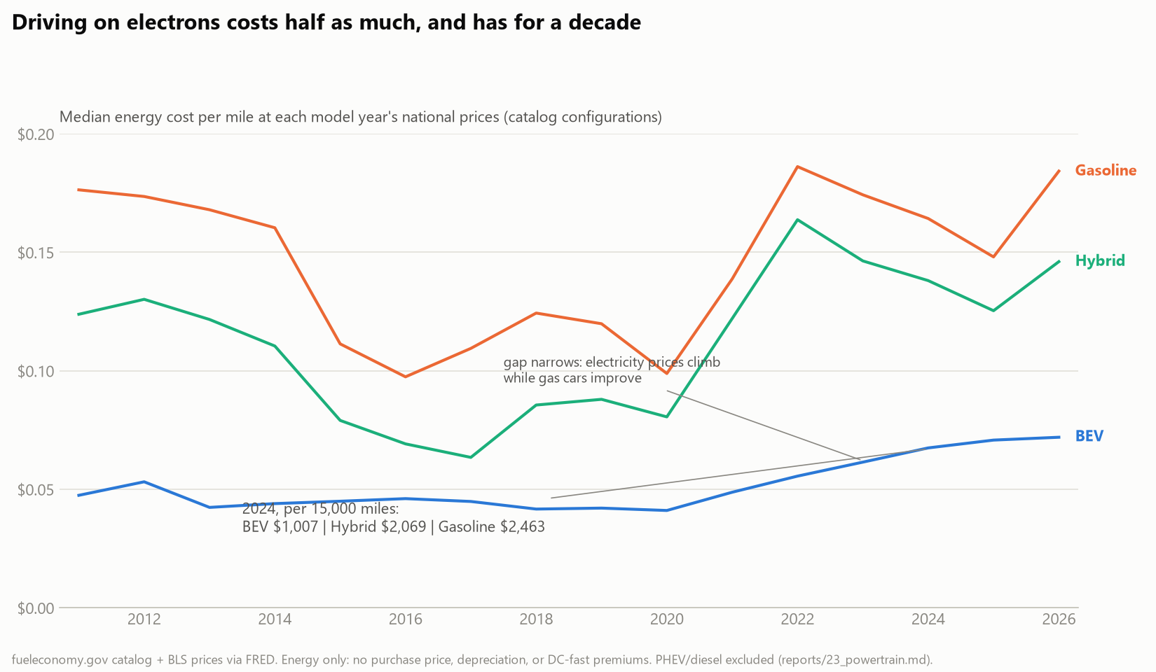
BACKUP Driving on electrons has cost half as much for a decade
Median energy cost per mile at each year's national prices: BEV 5-7 cents, gasoline 10-19. The 2024 gap is $1,007 vs $2,463 per 15,000 miles, and it narrows late as electricity prices climb while gas cars improve.
fueleconomy.gov catalog x BLS prices; reports/23_powertrain.md.
Notes:
Use for fuel-cost trend questions; energy only.

Slide 28
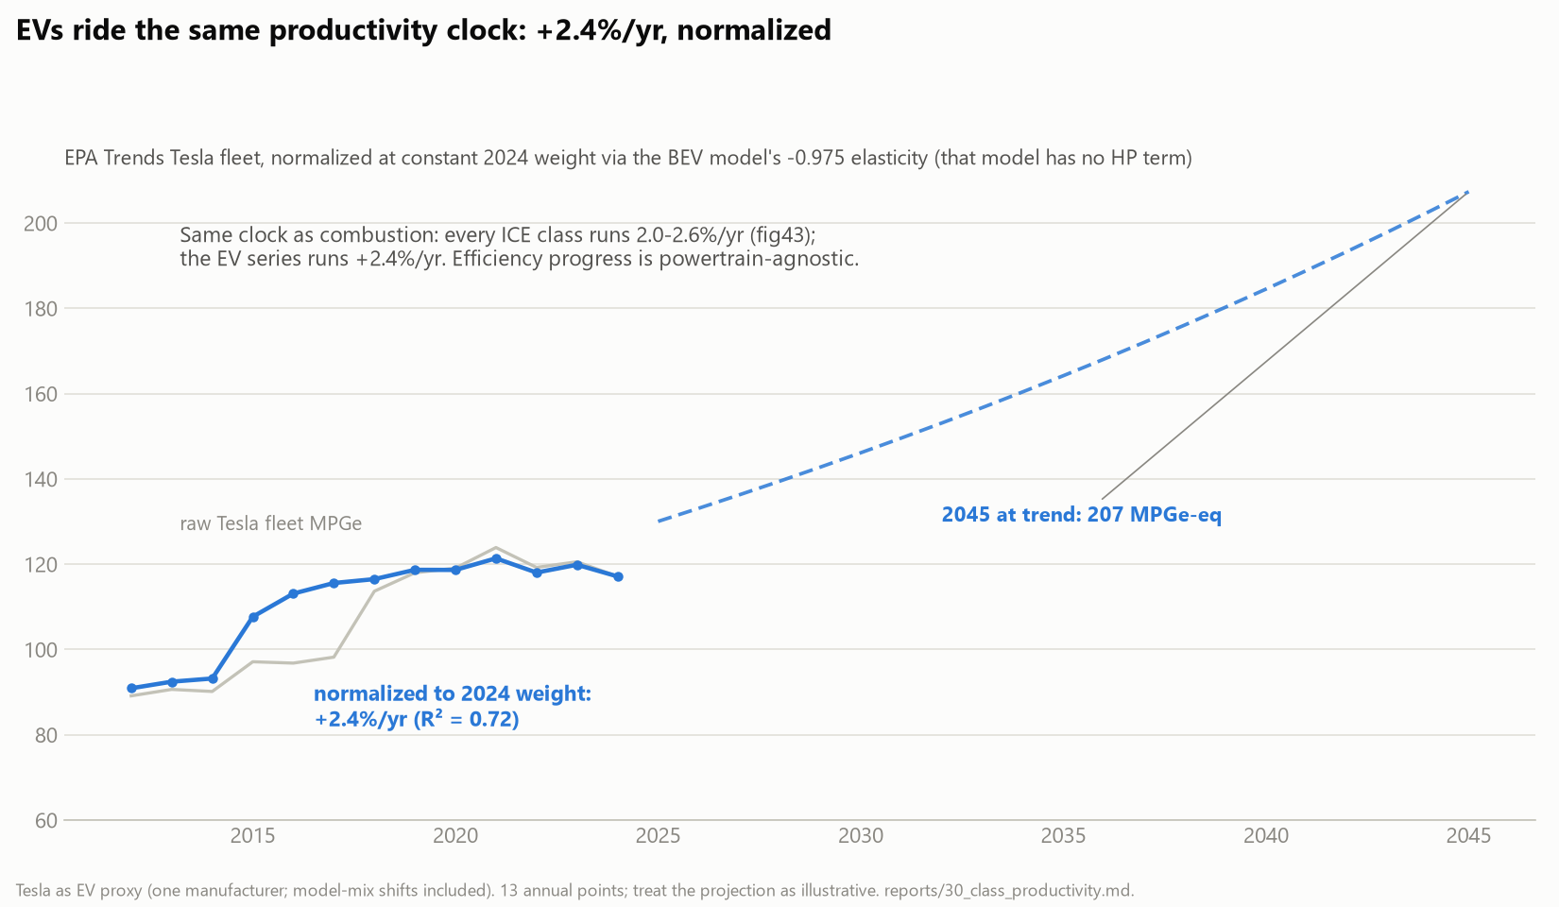
BACKUP EVs ride the same productivity clock
The only production-weighted EV series with weight (EPA Trends' Tesla rows, 2012-2024), normalized with the BEV model's -0.975 elasticity: +2.36% per year, inside the combustion band. One clock, two energy carriers.
Tesla as proxy, 13 points, model-mix included; reports/30_class_productivity.md.
Notes:
Use for 'do EVs improve faster?'

Slide 29
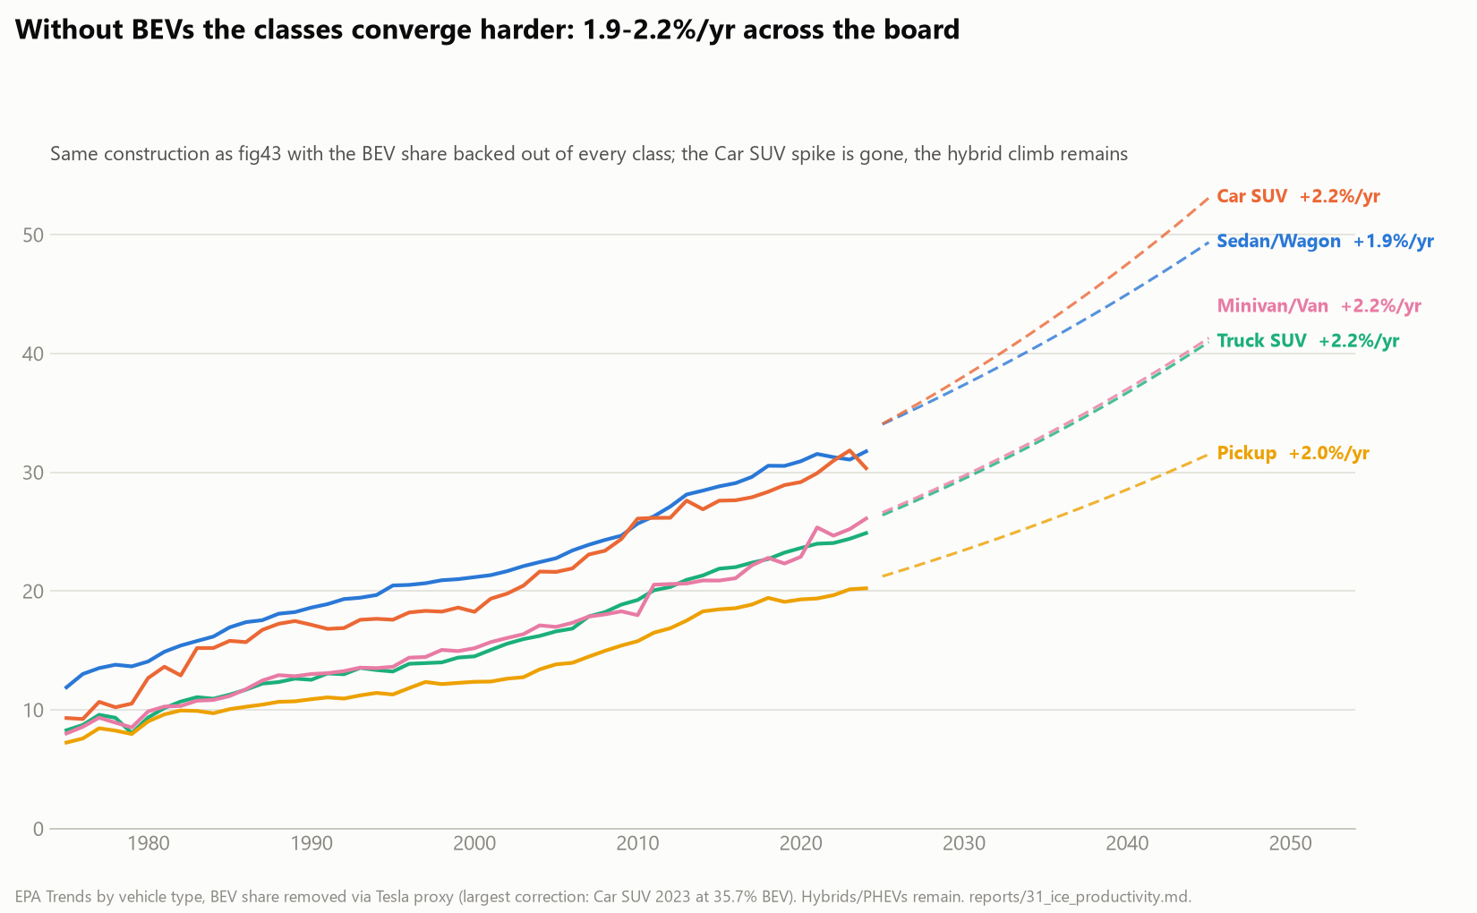
BACKUP The 2023 Car SUV spike was the Model Y, and it vanishes ex-BEV
In-class BEV share went 0.6% (2019) to 35.7% (2023); remove it and the spike is gone, classes converging to 1.9-2.2% per year. The 2024 endpoint wiggle is mix, not missing data: 2024 is final (2025 is the preliminary year, excluded); the sedan dip disappears ex-BEV; the residual Car SUV dip is a lighter, less powerful 2024 ICE fleet plus first-order Tesla-proxy sensitivity at the 35.7% point.
reports/31_ice_productivity.md incl. the endpoint decomposition.
Notes:
Use for 'what is that spike?' and 'is 2024 incomplete?'

